Slide 1
Analysis of Surveys on Fingerprint Evidence
Tianyi Lan, Jacqueline Liu
Masters in Statistical Practice
Notes:
Main title: 40 pt. Arial
Presenter Name: 16 pt. Arial
Presenters Title: 16 pt. Arial Italic

Slide 2
Background and Data

Slide 3
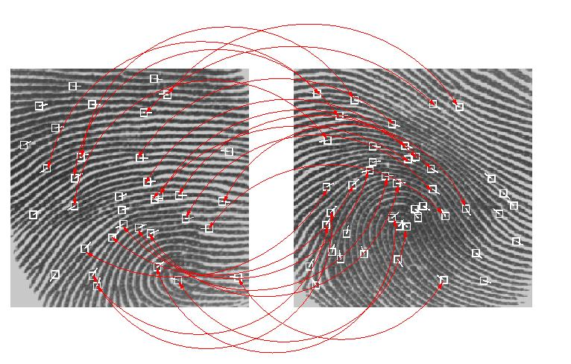
Fingerprint matches are not unique
Image Source: http://fingerprint-maritime.blogspot.com/2009/03/approaches-to-fingerprint-matching.html
Notes:
Don’t know how many other matches there are
Lay people (judges/jurors) tend to view matches as conclusive proof

Slide 4
A survey was conducted to understand effect of the presentation language
“I cannot exclude the defendant as a possible contributor of the print”
“In my opinion, the defendant is the source to a reasonable degree of scientific certainty"

Slide 5
Data Overview
998 Participants
600 Sample
398 Other

Slide 6
Data Overview
user
metadata
study eligibility
content
demographics
11
5
10
9
Notes:
11,
5,
10,
9

Slide 7
Response variable of interest was “perceived strength of evidence”
Six different questions, aggregated through averages
0-100% responses converted into 1-7 bins
“How confident are you that the fingerprint on the cash register tray was left by the defendant?”

Slide 8
Replication of Kadane’s analysis drove greater understanding of the data
conditions | estimate | p-value | lower | upper
1 vs. 7 | 0.207 | 0.526 | -0.851 | 0.437
2 vs. 8 | 0.547 | 0.124 | -1.245 | 0.152
3 vs. 9 | 0.127 | 0.721 | -0.829 | 0.576
4 vs. 10 | 0.203 | 0.591 | -0.951 | 0.544
5 vs. 11 | -0.097 | 0.799 | -0.654 | 0.847
6 vs. 12 | 0.187 | 0.596 | -0.882 | 0.509

Slide 9
Proceeded with two types of analysis:
replication
conviction proneness
incomplete responses

Slide 10
Feature Engineering: User Engagement

Slide 11
Engagement is determined by comments section
“Do you have any comments for the researchers regarding this survey?”
395 did… to an extent

Slide 12
205 people left the section blank. Others said:
good
no
VERY GOOD
interesting
none
i like it
interesting topic
none
none
is very good
none
great survey very interesting

Slide 13
205 people left the section blank. Others said:
good
no
VERY GOOD
interesting
none
i like it
interesting topic
none
none
is very good
none
great survey very interesting
“es una tema bastante delicado”

Slide 14
205 people left the section blank. Others said:
good
no
VERY GOOD
interesting
none
i like it
interesting topic
none
none
is very good
none
great survey very interesting
“It was a very thought provoking survey. I think just because the forensic scientist wasn't able to say the print was not left by Richard Johnson does not mean he is guilty.”

Slide 15
205 people left the section blank. Others said:
good
no
VERY GOOD
interesting
none
i like it
interesting topic
none
none
is very good
none
great survey very interesting
Engaged | Not Engaged | NA
197 | 198 | 205

Slide 16
Analysis: Conviction Proneness

Slide 17
Conviction Proneness
“Our criminal justice system should be less concerned about protecting the rights of the people charged with crimes and more concerned about convicting the guilty.”

Slide 18
Conviction Proneness
“Our criminal justice system should be less concerned about protecting the rights of the people charged with crimes and more concerned about convicting the guilty.”
Agreement | Strongly agree | Agree | Neutral | Disagree | Strongly disagree
Percentage | 15 | 27 | 31 | 20 | 7

Slide 19

Ordinal logistic regression was used to model the ordered categories
polr(): Proportional Odds Logistic Regression
$$Y=\log\left(\frac{p}{1−p}\right)$$

Slide 20
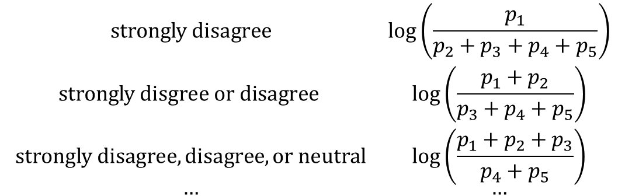
Ordinal logistic regression was used to model the ordered categories
polr(): Proportional Odds Logistic Regression
$$\begin{matrix}strongly disagree & \log\left(\frac{p_{1}}{p_{2}+p_{3}+p_{4}+p_{5}}\right) \\ strongly disgree or disagree & \log\left(\frac{p_{1}+p_{2}}{p_{3}+p_{4}+p_{5}}\right) \\ strongly disagree, disagree, or neutral & \log\left(\frac{p_{1}+p_{2}+p_{3}}{p_{4}+p_{5}}\right) \\ … & …\end{matrix}$$

Slide 21
Forward selection chose 5 (of 11) predictors
Law Experience
Conviction Proneness
CSI Frequency
Jury Experience
User Engagement
Political view

Slide 22
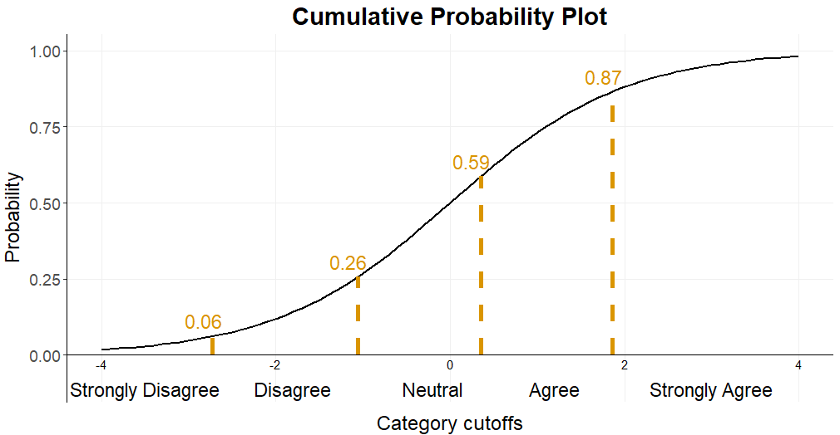
Model output: cutoffs and corresponding cumulative probabilities
Baseline:
Conservative
No jury experience
No law experience
No comments
Rarely watches CSI

Slide 23
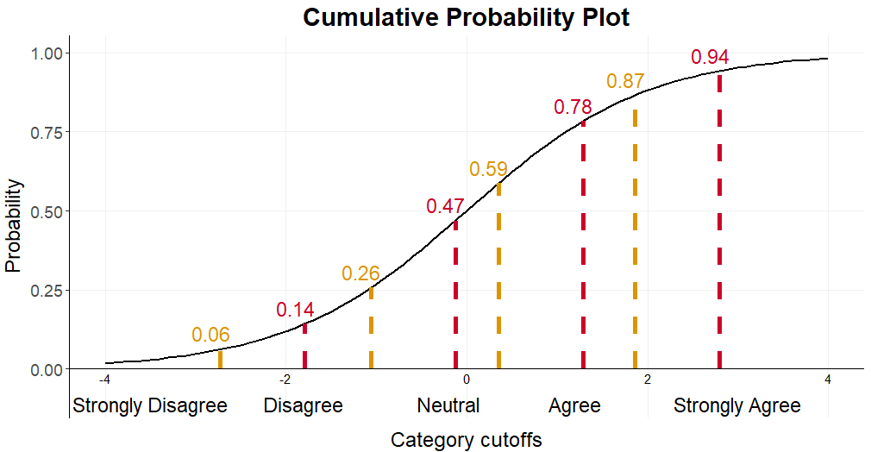
Model output: cutoffs and corresponding cumulative probabilities
New criteria:
Liberal
No jury experience
No law experience
No comments
Rarely watches CSI

Slide 24
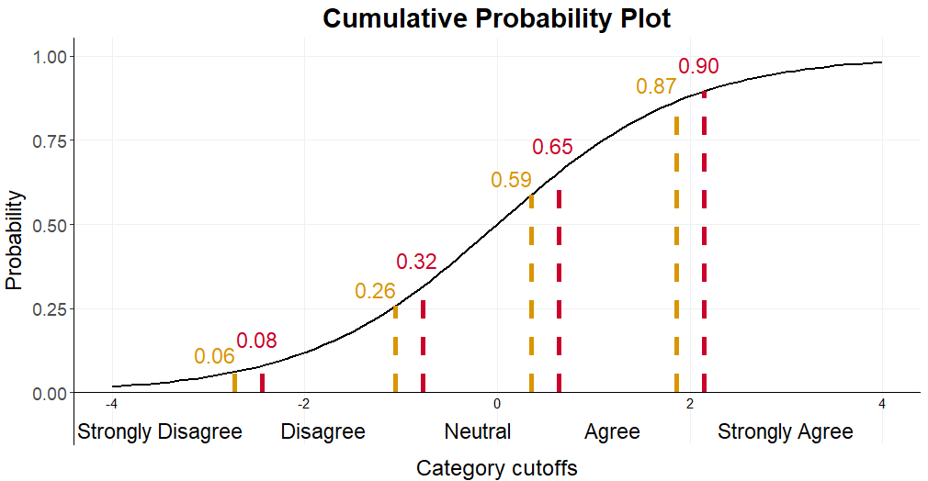
Model output: cutoffs and corresponding cumulative probabilities
New criteria:
Conservative
No jury experience
Has law experience
No comments
Rarely watches CSI

Slide 25
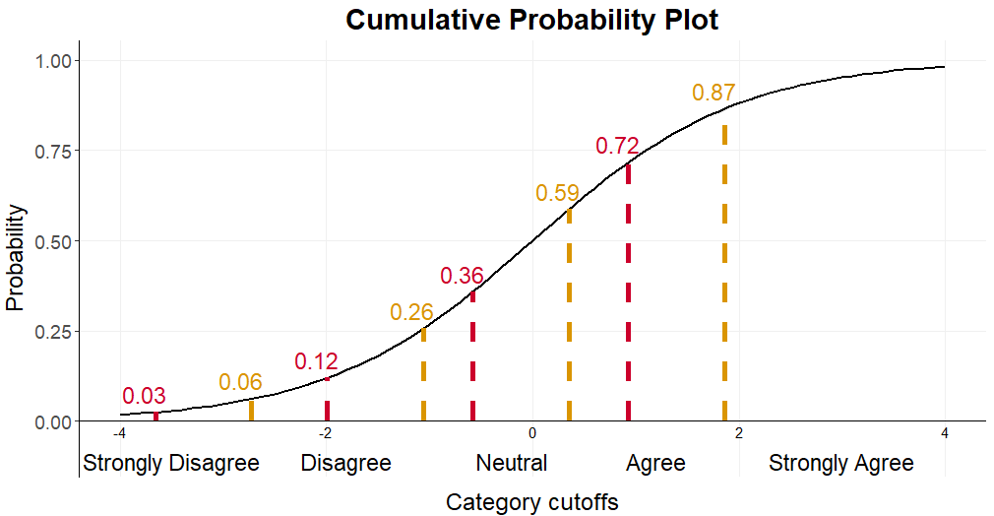
Model output: cutoffs and corresponding cumulative probabilities
New criteria:
Conservative
No jury experience
No law experience
No comments
Watches CSI several times per week

Slide 26
Political view and frequency of watching CSI and similar shows are the strongest predictors
Political view: Liberal | -0.932
Has jury experience | -0.310
Has law experience | -0.282
Is engaged with survey | 0.403
CSI frequency: Several times / week | 0.934

Slide 27
Analysis: Incomplete Data

Slide 28
Motivating Question
Are those who completed the survey representative of those who did not?
If not, in what aspects are
the two groups different?

Slide 29
Breakdown of the responses
All participants
Not jury-eligible
Jury-eligible
Read
Incomplete
Complete
Quota full
Didn’t read
Screened
3
998
1
864
4
608
600

Slide 30
A closer look at the incomplete responses
 | group | q3 | q4 | q5 | q6 | q7 | q8 | q9 | q10 | q11 | q12 | q14 | q15 | q16 | q17 | q18
Alice | 2 | 4 | 4 | 4 | 50 | 4 | 50 | 4 | 4 | 4
Bob | 3 | 7 | 7 | 7 | 100 | 7 | 99 | 7 | 6 | 1 | 1 | 1 | 2 | 4 | 1
Eve | 3 | 3 | 3 | 3 | 50 | 3 | 50

Slide 31
A closer look at the incomplete responses
 | group | q3 | q4 | q5 | q6 | q7 | q8 | q9 | q10 | q11 | q12 | q14 | q15 | q16 | q17 | q18
Alice | 2 | 4 | 4 | 4 | 50 | 4 | 50 | 4 | 4 | 4
Bob | 3 | 7 | 7 | 7 | 100 | 7 | 99 | 7 | 6 | 1 | 1 | 1 | 2 | 4 | 1
Eve | 3 | 3 | 3 | 3 | 50 | 3 | 50

Slide 32
A closer look at the incomplete responses
 | group | q3 | q4 | q5 | q6 | q7 | q8 | q9 | q10 | q11 | q12 | q14 | q15 | q16 | q17 | q18
Alice | 2 | 4 | 4 | 4 | 50 | 4 | 50 | 4 | 4 | 4
Bob | 3 | 7 | 7 | 7 | 100 | 7 | 99 | 7 | 6 | 1 | 1 | 1 | 2 | 4 | 1
Eve | 3 | 3 | 3 | 3 | 50 | 3 | 50
strength of evidence
confidence in expert
demographics

Slide 33
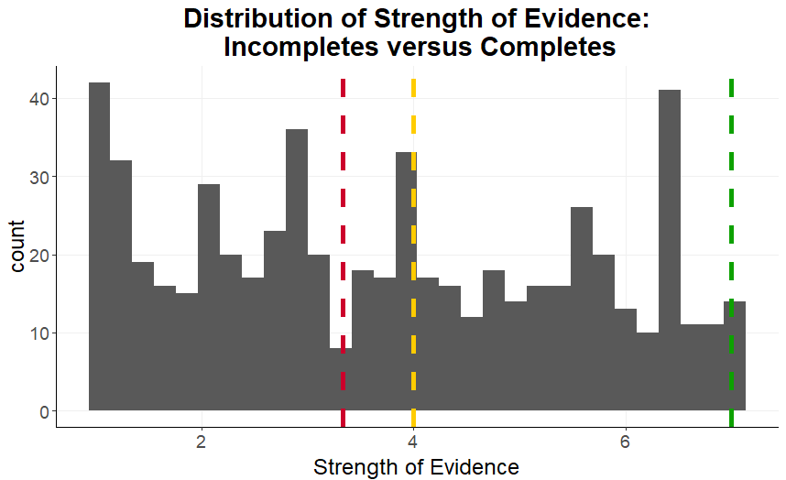
Incomplete responses are not outliers

Slide 34
It is not uncommon for an individual to give the same answer to all questions
 | q3 | q4 | q5 | q6 | q7 | q8
Alice | 4 | 4 | 4 | 50 | 4 | 50
Bob | 7 | 7 | 7 | 100 | 7 | 99
Eve | 3 | 3 | 3 | 50 | 3 | 50
low | mid | high
42 | 17 | 14

Slide 35
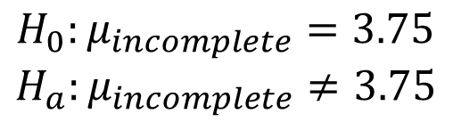
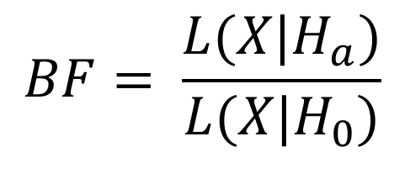
Bayesian hypothesis testing
$$BF= \frac{L(X|H_{a})}{L(X|H_{0})}$$
$$H_{0}:μ_{incomplete}=3.75$$
$$H_{a}:μ_{incomplete}≠3.75$$

Slide 36
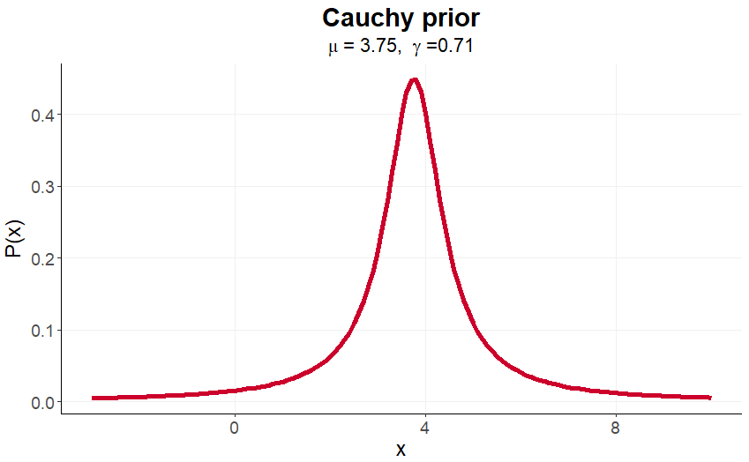
It’s Bayesian because there is a prior

Slide 37
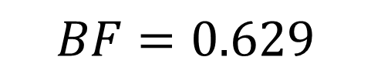
Bayes factor shows weak evidence in favor of null hypothesis
Bayes Factor | Label for H₀
1 | No evidence
1/3 – 1 | Anecdotal evidence
1/10 – 1/3 | Moderate evidence
1/30 – 1/10 | Strong evidence
1/100 – 1/30 | Very strong evidence
< 1/100 | Extreme evidence
$$BF=0.629$$

Slide 38
Future Work

Slide 39
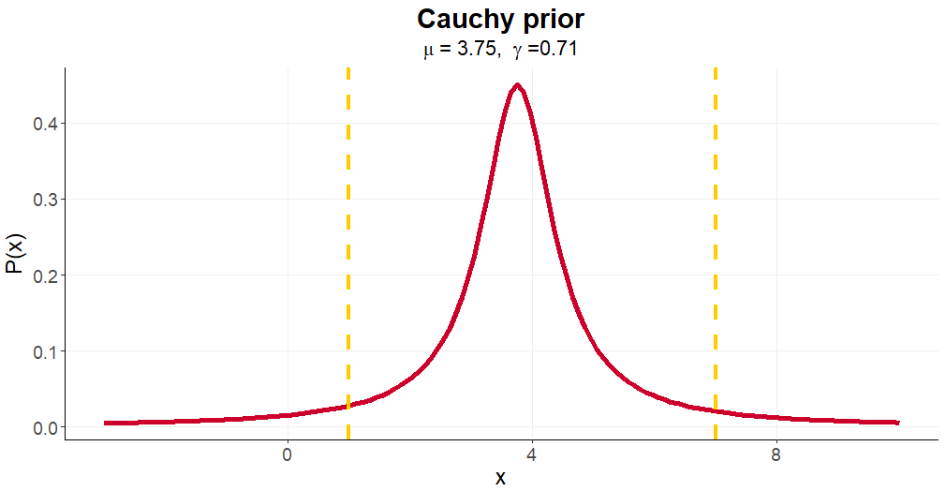
More appropriate priors could be chosen for Bayesian hypothesis testing

Slide 40
Filtering by reading comprehension questions could lead to biased results
All participants
Not jury-eligible
Jury-eligible
Read
Incomplete
Complete
Quota full
Didn’t read
Screened
3
998
1
864
4
608
600

Slide 41
Thank you
Questions?
Notes:
Main title: 40 pt. Arial
Presenter Name: 16 pt. Arial
Presenters Title: 16 pt. Arial Italic

Slide 42
Ordinal accuracy
Outcome | Strongly disagree | Disagree | Neutral | Agree | Strongly Agree
Prediction
Strongly disagree | 0 | 0 | 0 | 0 | 0
Disagree | 3 | 7 | 8 | 8 | 2
Neutral | 31 | 91 | 126 | 95 | 43
Agree | 6 | 19 | 51 | 56 | 39
Strongly Agree | 1 | 3 | 2 | 4 | 5

Slide 43
Class imbalance is a likely culprit
Strongly disagree | Disagree | Neutral | Agree | Strongly Agree
41 | 120 | 187 | 163 | 89

Slide 44
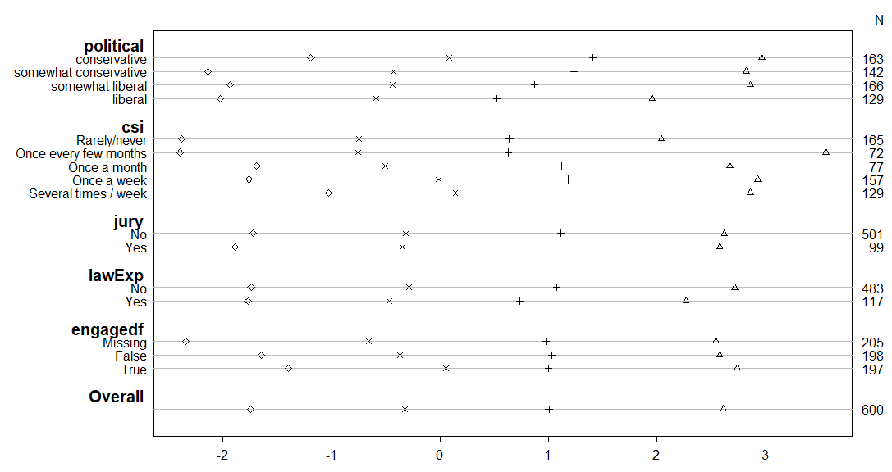
Proportional odds assumption is questionable

